Slide 1
Automated Hyperspectral Pyrometry of Floating Zone Growths
Naman Parikh¹, David Elbert², Tyrel McQueen³
¹Department of Physics, Carnegie Mellon University
²Hopkins Extreme Materials Institute
³Department of Chemistry, Johns Hopkins University

Slide 2
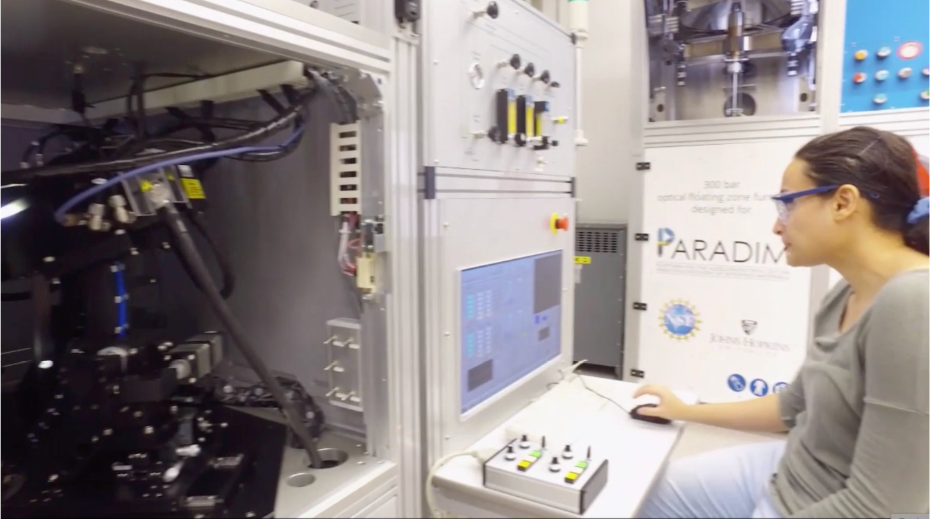
Laser Diode Floating Zone

Slide 3
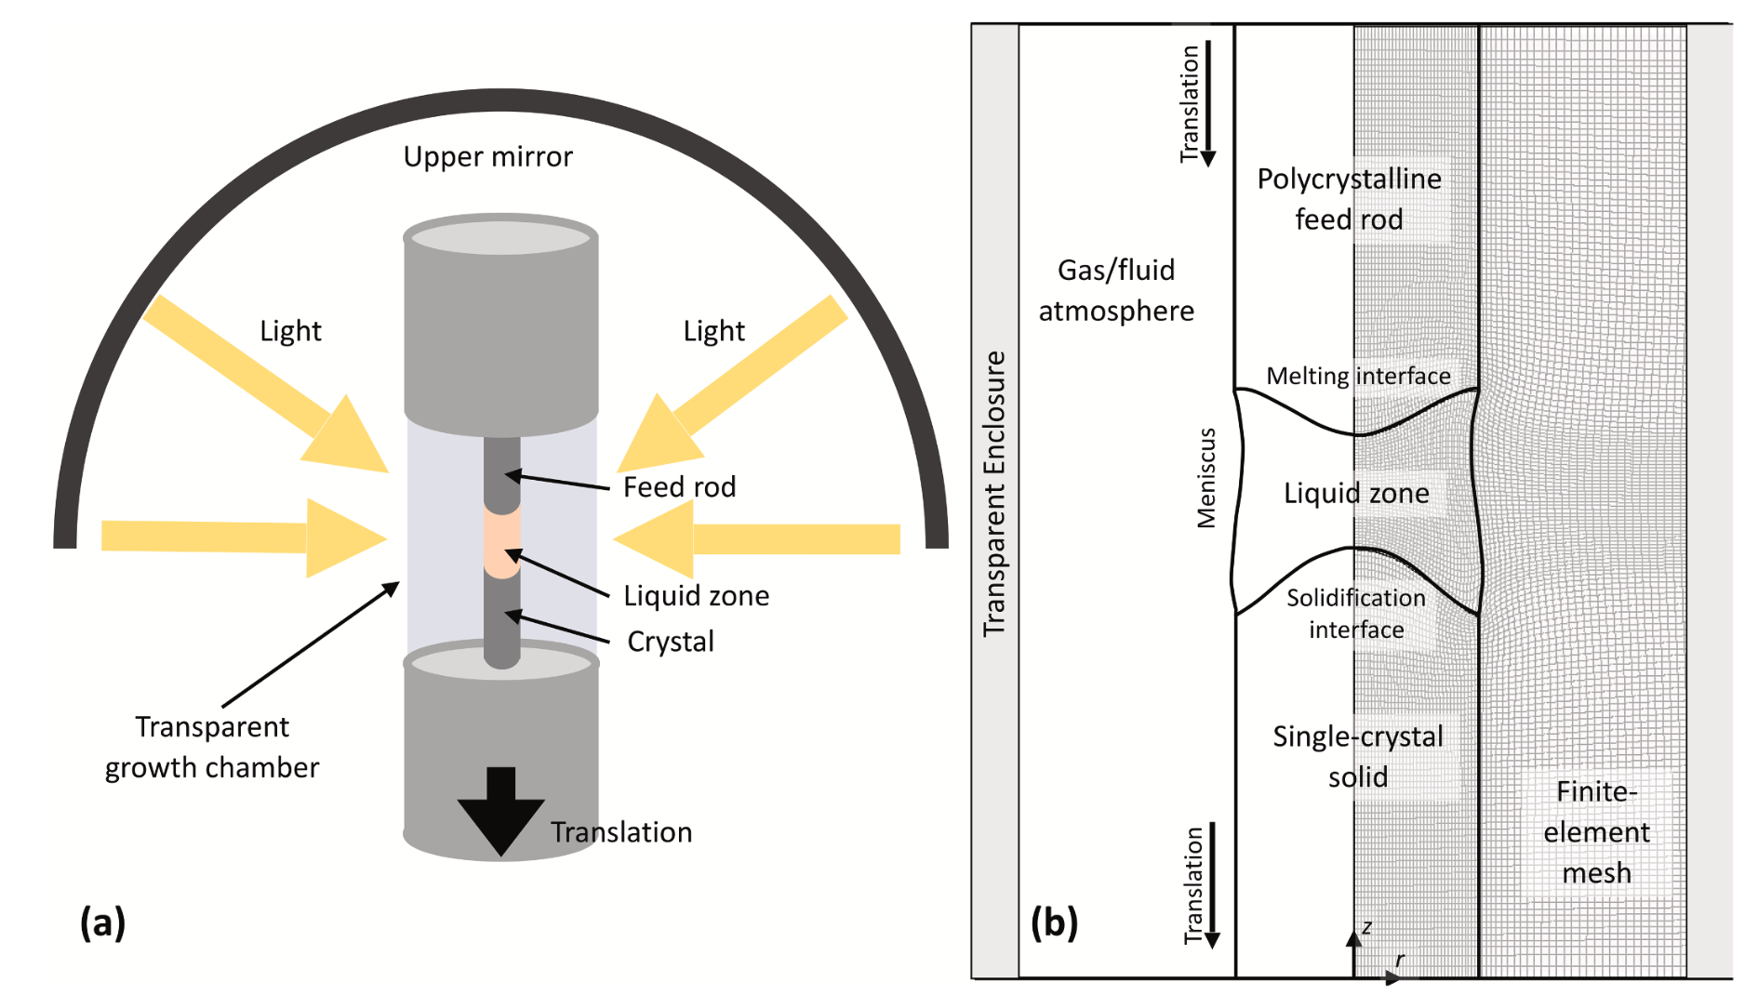
Scott S. Dossa, Jeffrey J. Derby
https://doi.org/10.1016/j.jcrysgro.2022.126723

Slide 4
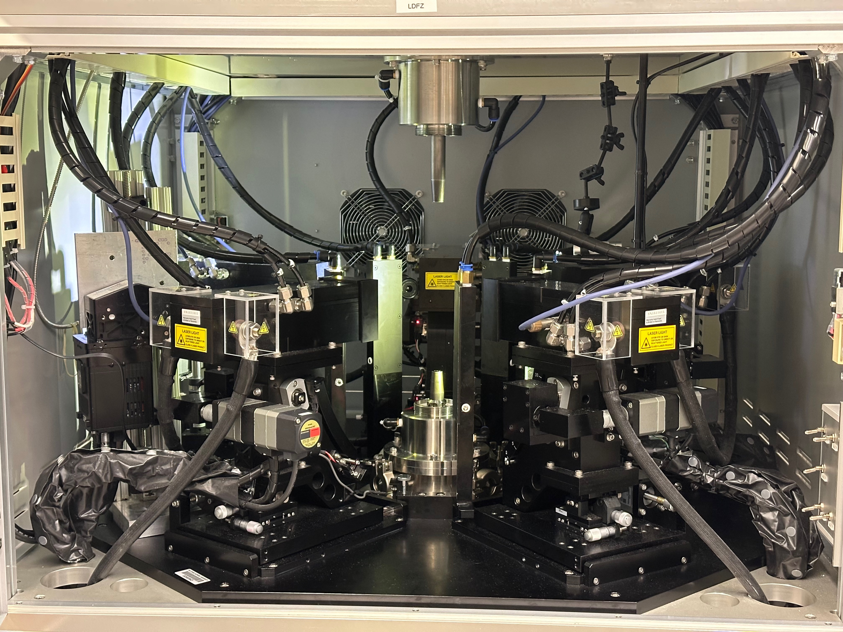

Slide 5
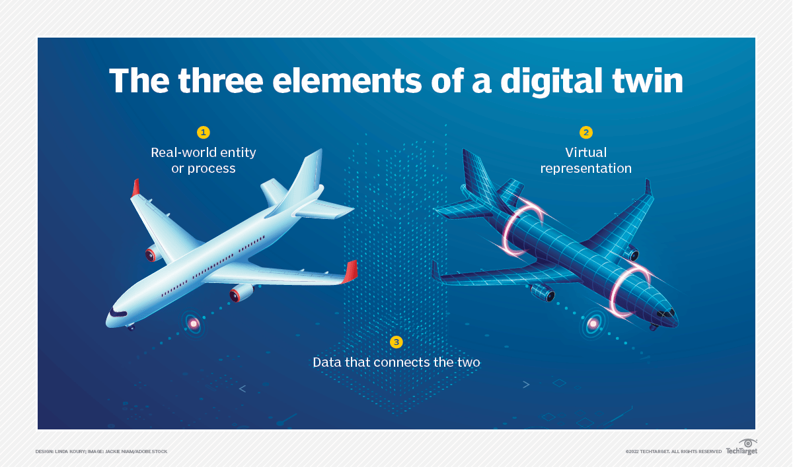

Slide 6
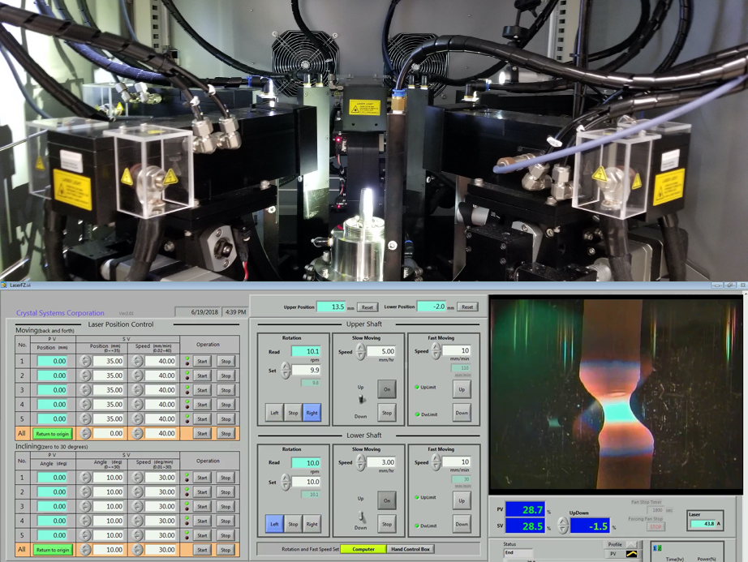
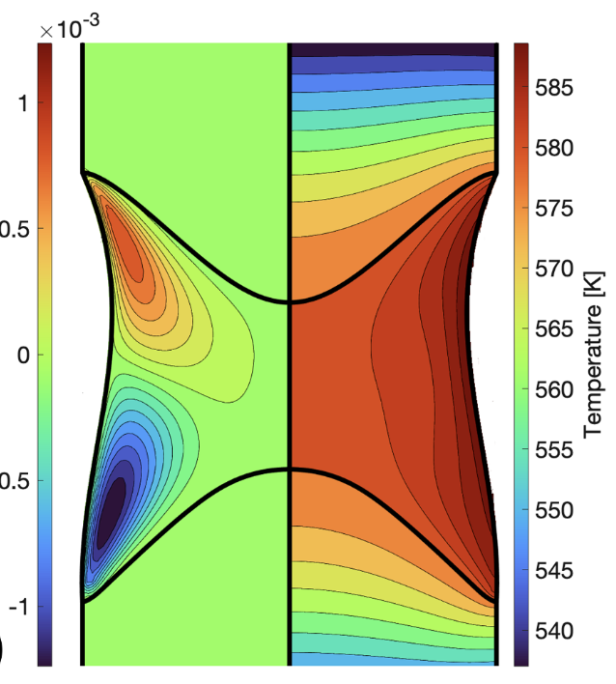
Physical
Digital
Data
?
Scott S. Dossa, Jeffrey J. Derby
https://doi.org/10.1016/j.jcrysgro.2022.126723
Notes:
So, what are these 3 elements for floating zone growths? The physical aspect would be the growth itself, the process of the growth and the underlying physics that governs the growth. Also an important part of the physical element is the controls of the furnace. The experimenter can change things like the rotation speed and pull rate, and these affect the growth. The last physical element is the crystal the is made at the end. Whether it’s a single or multiple crystal, it’s structure, and it’s properties. The digital twin that is being made in other work is computational models and simulations of the growths. This includes finite element models to track the thermal distribution and fluid flow during a growth. Currently, these models have had some success in different ways of simulating the molten zone and solid-liquid interface, but they are informed only by physics theory and not actual growth data, and they are not validated against physical growths. So, they are fundamentally disconnected because of the lack of data.

Slide 7
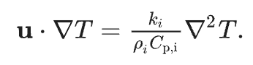
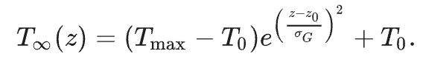
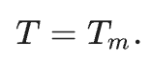
Modeling – NaNO₃
Scott S. Dossa, Jeffrey J. Derby
https://doi.org/10.1016/j.jcrysgro.2022.126723
7
Notes:
What makes these models difficult to use because the inputs for the models are not the same as the inputs for a physical growth. For a physical growth, we have things like the laser power and pull rate, but the input for the models is things like the temperature field, which we don’t know how to measure for a physical growth. IF I WANT TO USE THE MODEL TO INFORM MY GROWTH, I need some way to measure the temperature distribution so I can then input it into the model. Additionally, the model doesn’t know how to determine how the heat will flow as the samples are heated up during the growth. Temperature is missing as data for the physical growths and because of this is missing from the model’s ability to predict. So, data that would be useful in developing a digital twin is the temperature distributions of growths.

Slide 8
Modeling – NaNO₃
Scott S. Dossa, Jeffrey J. Derby
https://doi.org/10.1016/j.jcrysgro.2022.126723
8

Slide 9
Digital Twins
“Set of virtual information constructs that mimics the … system”
“Has a predictive capability”
“Informs decisions that realize value”
“Dynamically updated with data from it’s physical twin”
National Academies of Sciences, Engineering, and Medicine
https://doi.org/10.17226/26894

Slide 10
Digital Twins
“Set of virtual information constructs that mimics the … system”
“Has a predictive capability”
“Dynamically updated with data from it’s physical twin”
National Academies of Sciences, Engineering, and Medicine
https://doi.org/10.17226/26894

Slide 11
Research Question
How can we collect temperature data from lab growths?

Slide 12
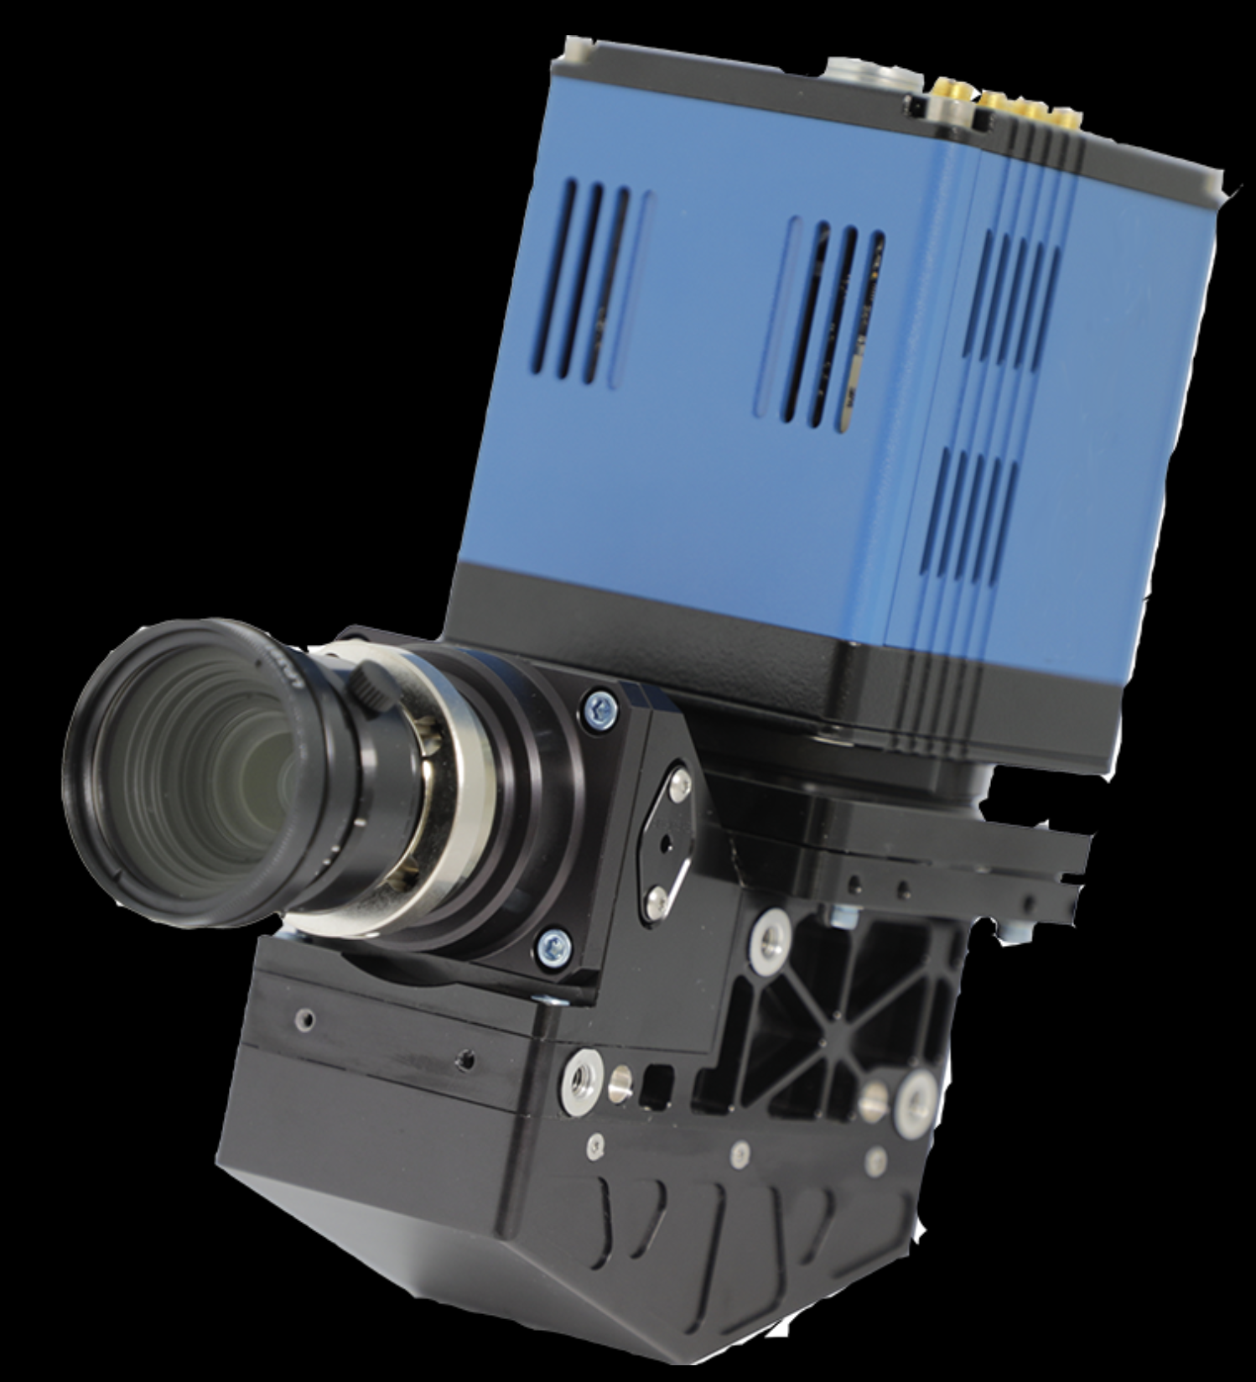
Hyperspectral Camera

Slide 13
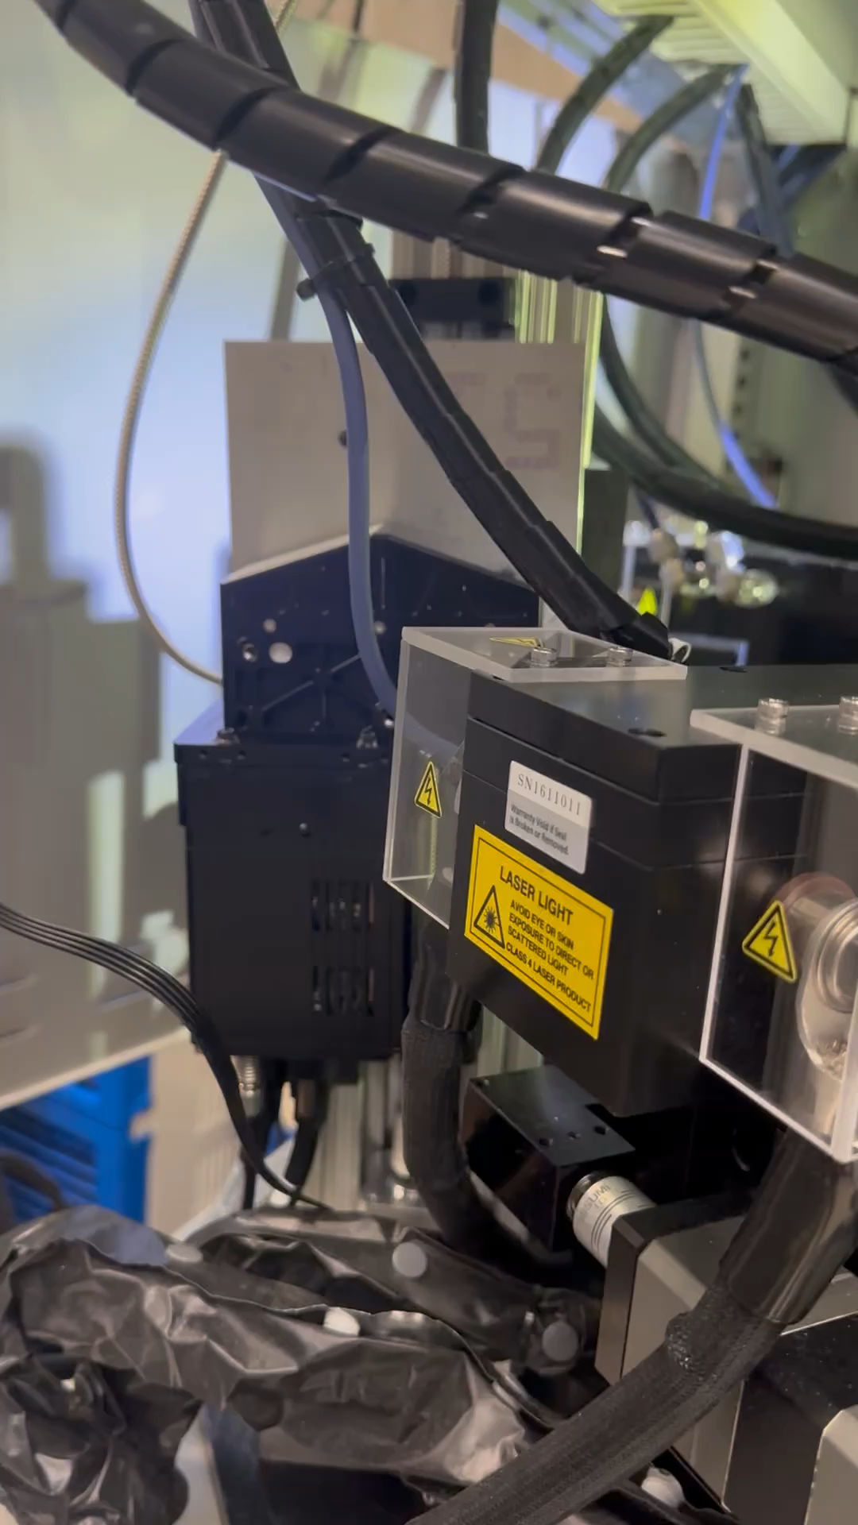
What are the steps?
Collect data
Analyze the data

Slide 14
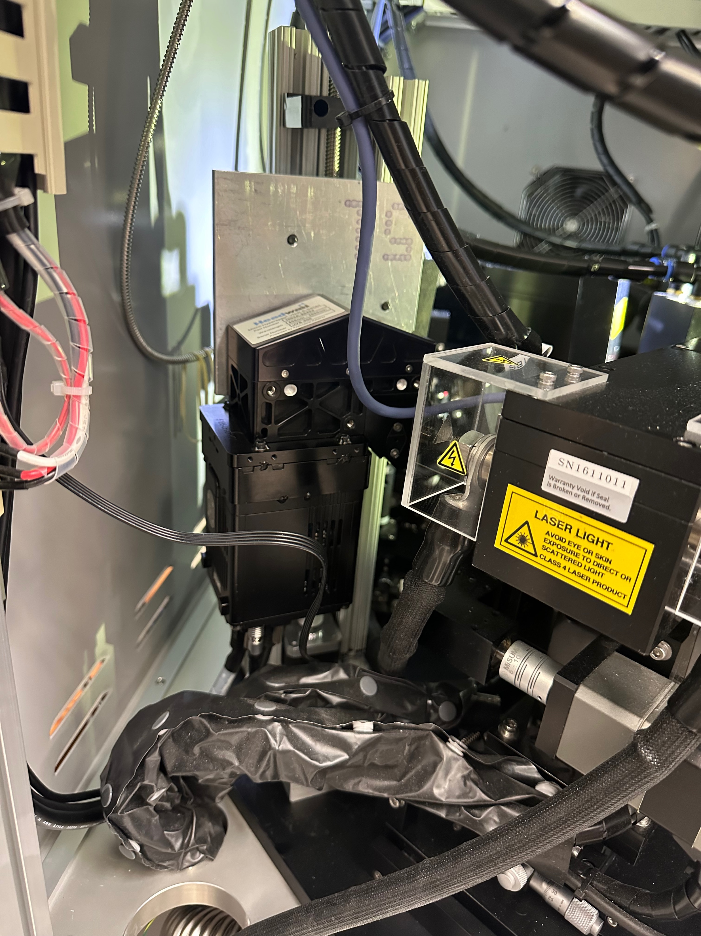

Slide 15
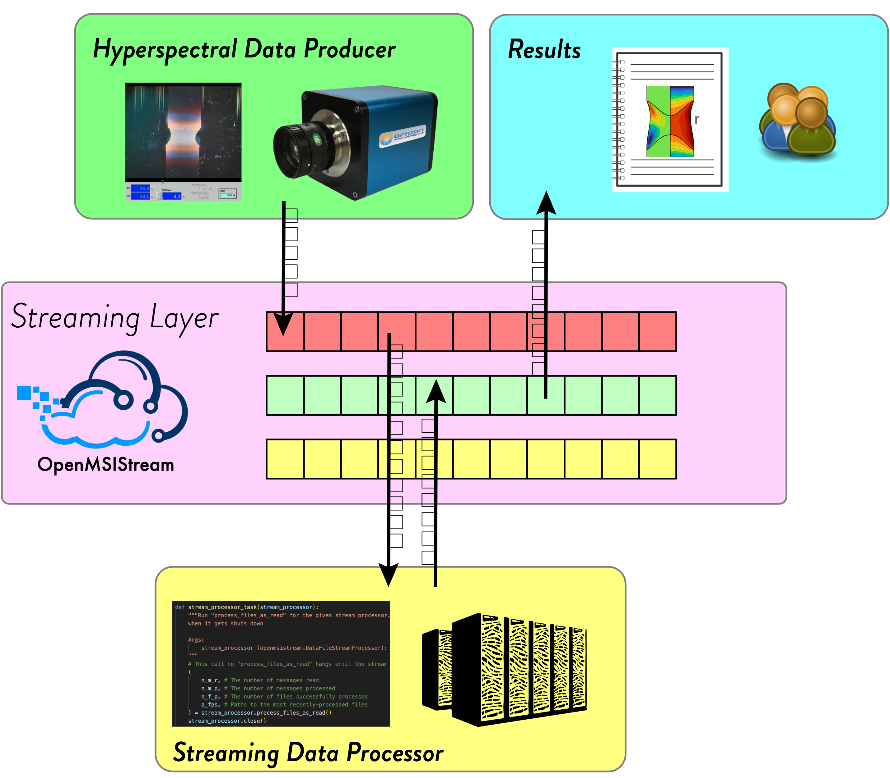

Slide 16
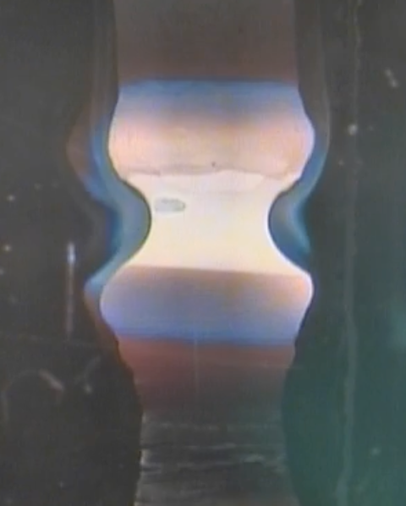
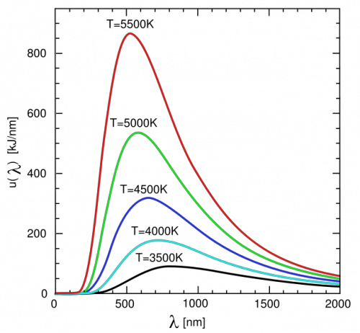
Analysis
Blackbody

Slide 17
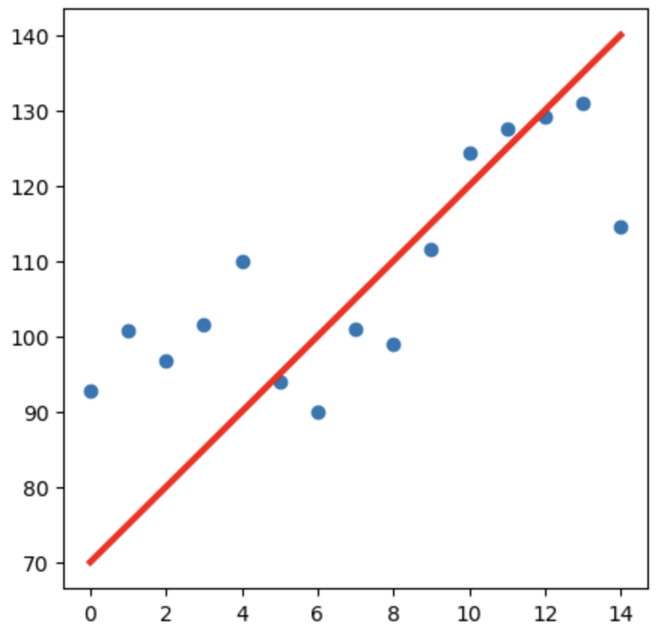
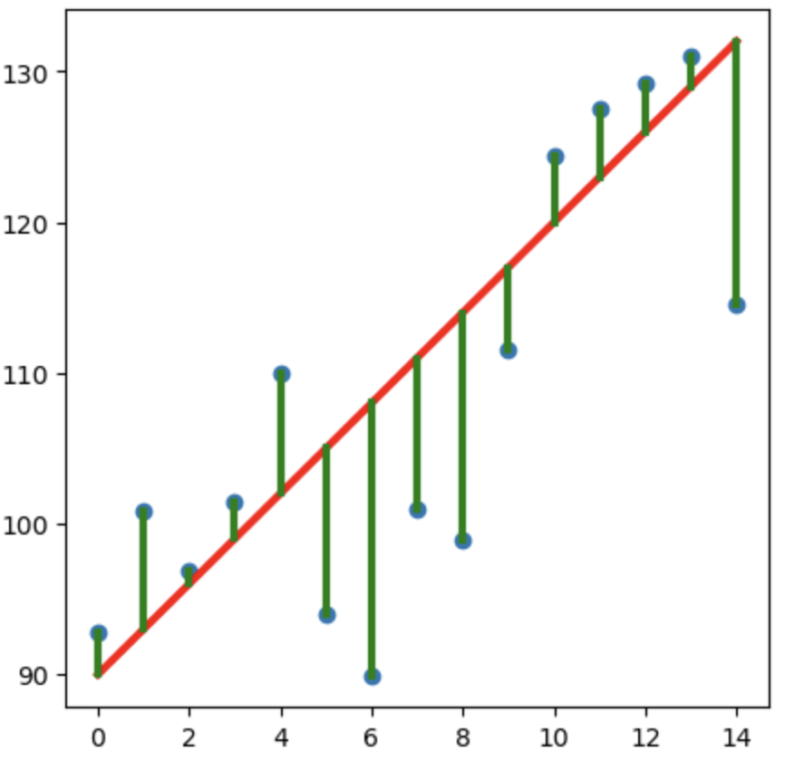
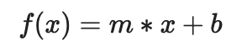
Least Squares Regression
Model Function
Guess Parameters
Minimize Residuals
Parameters

Slide 18
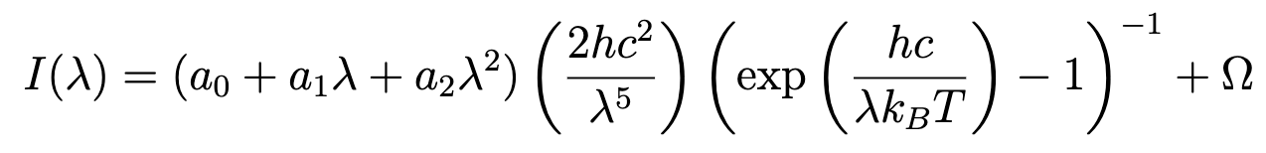
Blackbody Model Function
Emissivity
Stray Light Offset
Parameters

Slide 19
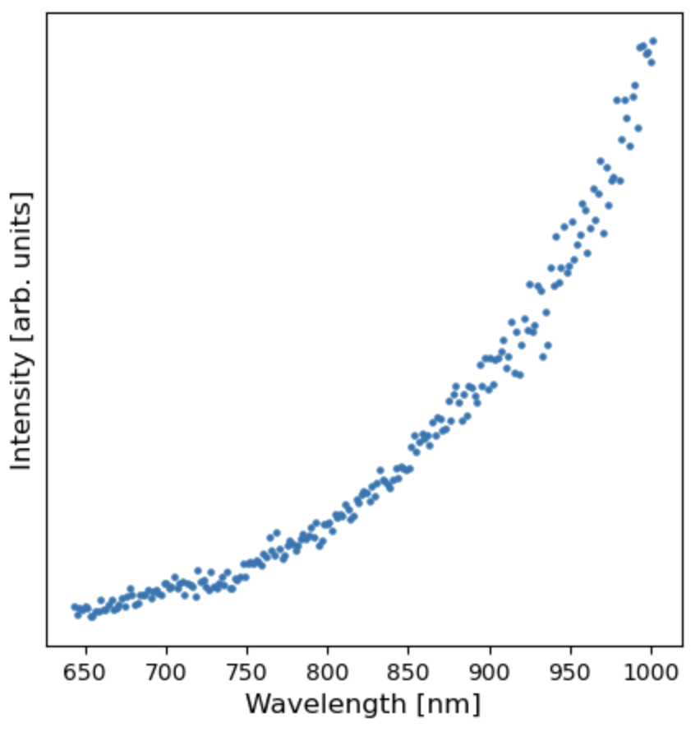
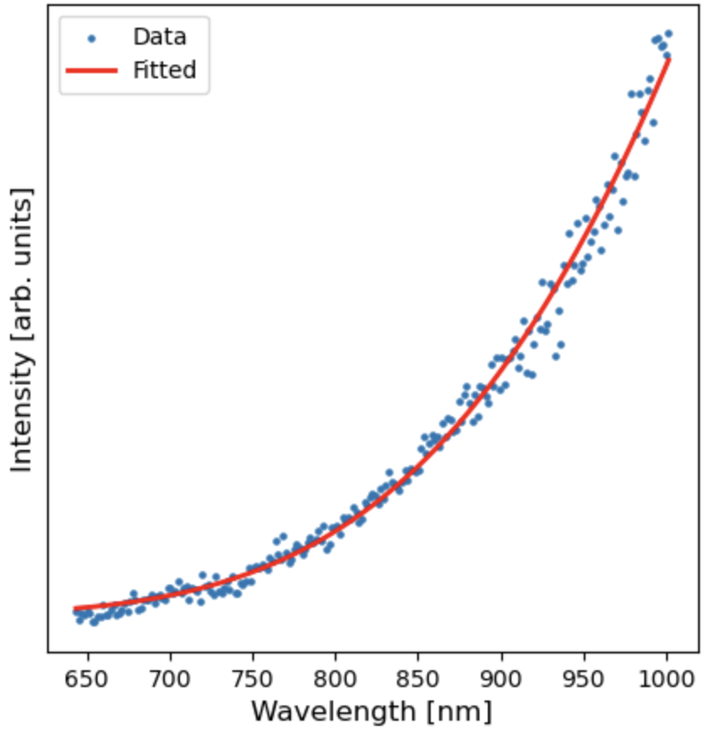
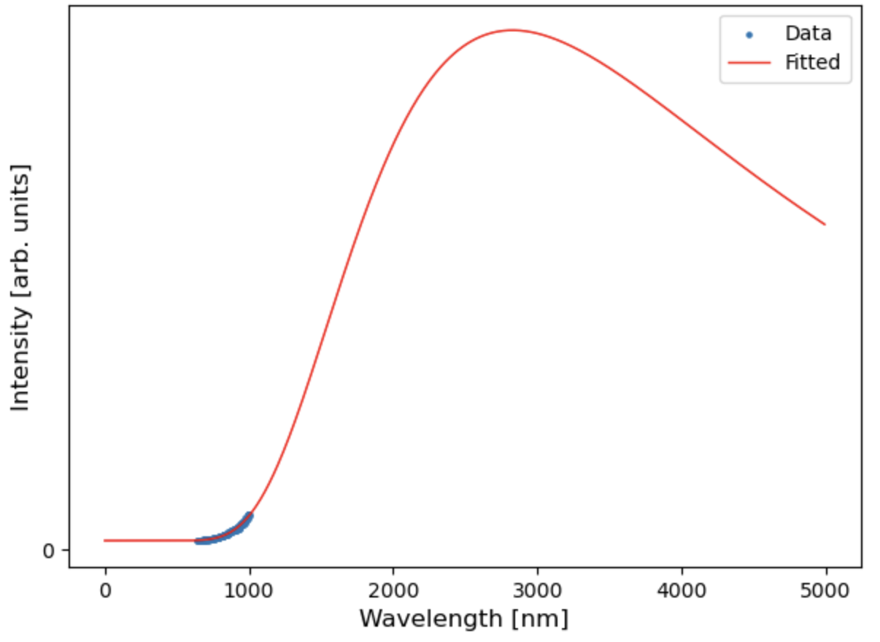
Run the Regression
Data
Fitted with T=1298 K
Full Spectrum

Slide 20
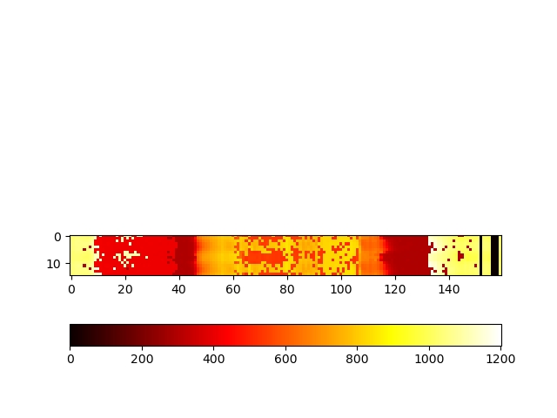
Into the furnace
Kelvin
20

Slide 21
What’s next?
Optimizing the analysis
Collect tons of data
Validate and inform models
Notes:
Optimizations include performance improvement and potentially needing to reduce sensitivity to atomic emission spikes

Slide 22
Physical
Digital
Autonomous Experimentation
Data

Slide 23
Physical
Digital
Measurement
Predictions
Data
Promising growths
Model validation and updating

Slide 24
Physical
Digital
Data
“Dynamically updated with data from it’s physical twin”
“Bidirectional interaction”
“Informs decisions that provide value”

Slide 25
Acknowledgements
Physical
Digital
Data
Evan Crites (McQueen Lab, PARADIM)
Maggie Eminizer (IDIES)
NSF Awards #2039380 (PARADIM) and #2129051 (VariMat)

Slide 26
Extra Slides – Other Carbon Rod Spectra

Slide 27
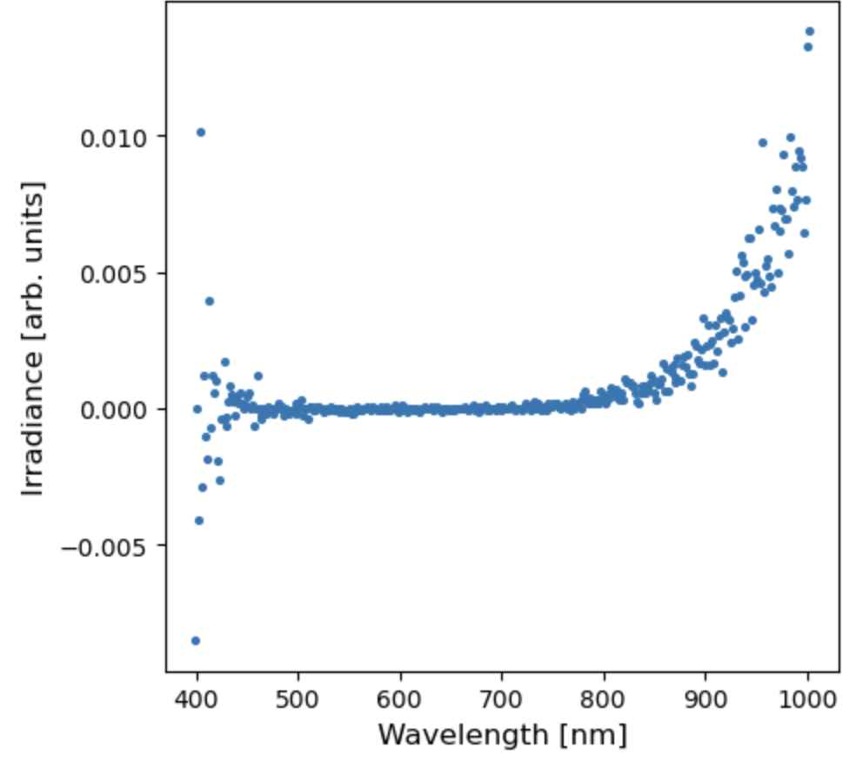
Carbon Rod Corrected

Slide 28
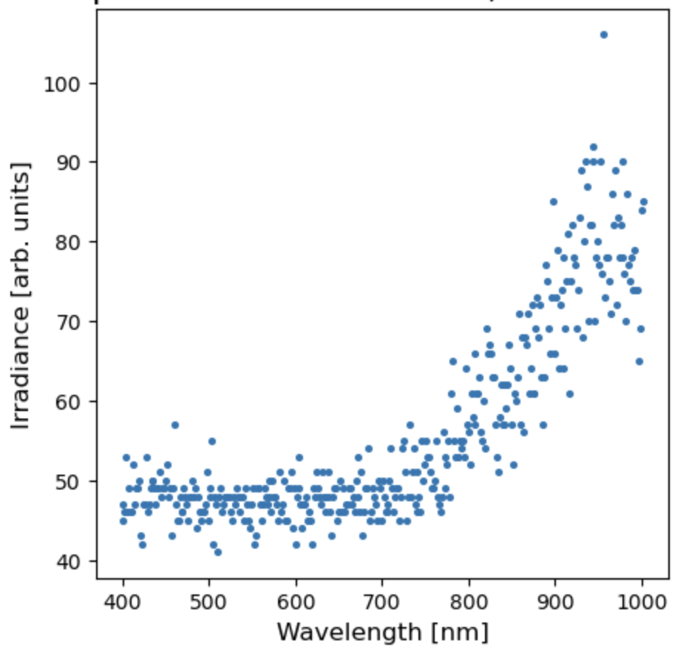
Carbon Rod Uncorrected

Slide 29
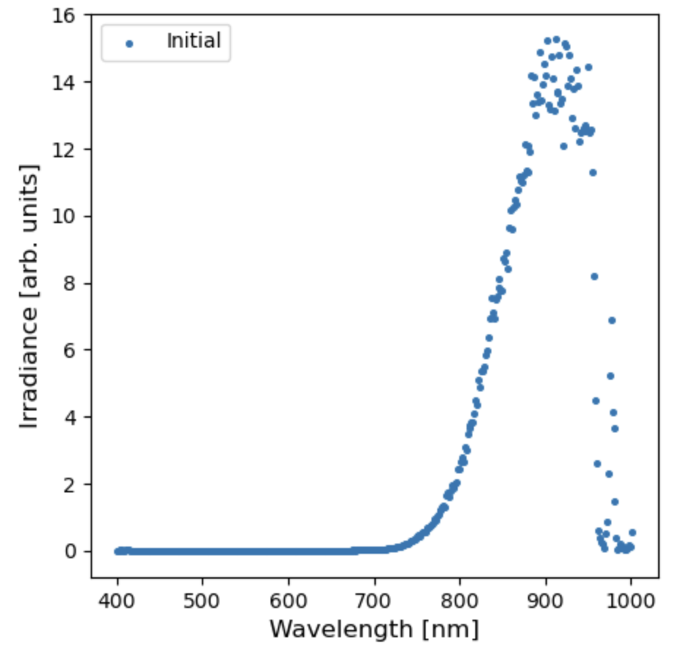
Notch Filter Dip

Slide 30
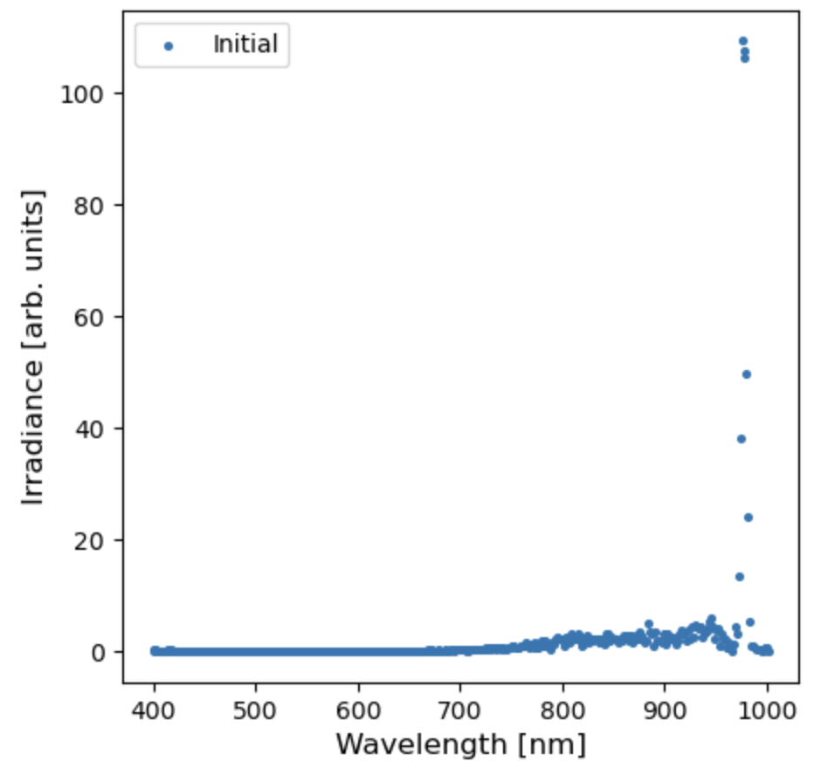
Laser Light Spike

Slide 31
Extra Slides – Camera Motion

Slide 32
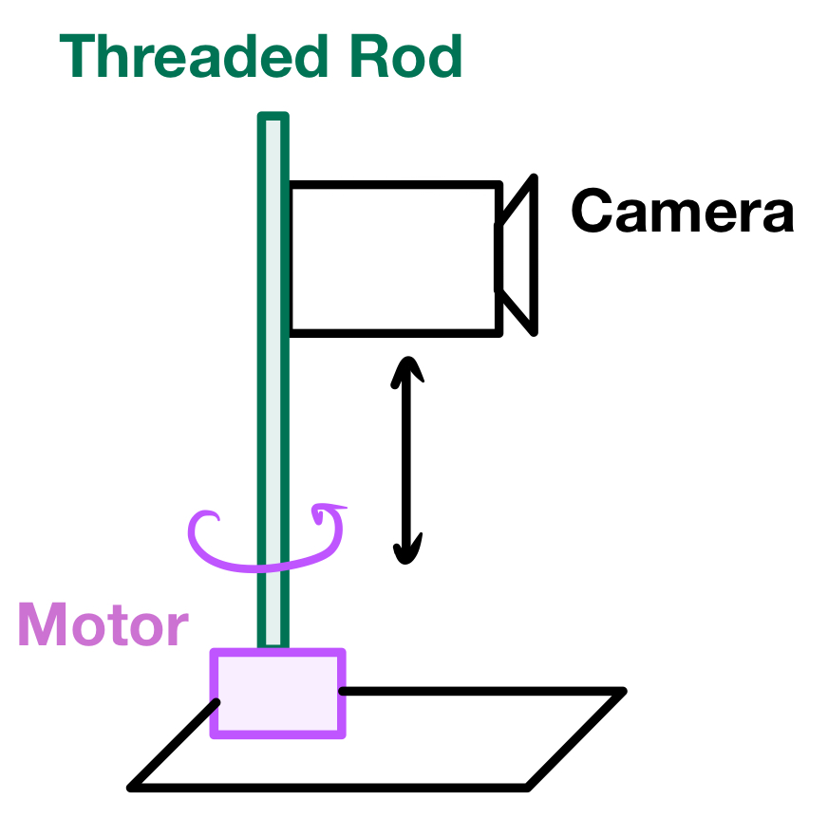
Notes:
How do we make it scan?

Slide 33
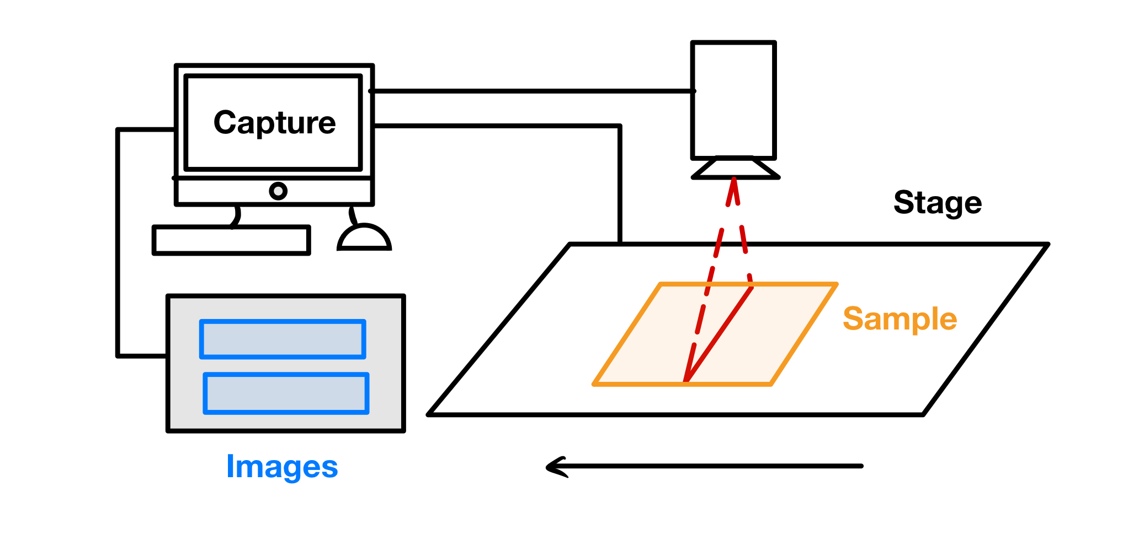
Notes:
Why does it need to move?
Important to note that the computer syncs the start of the image capture and the movement of the stage

Slide 34
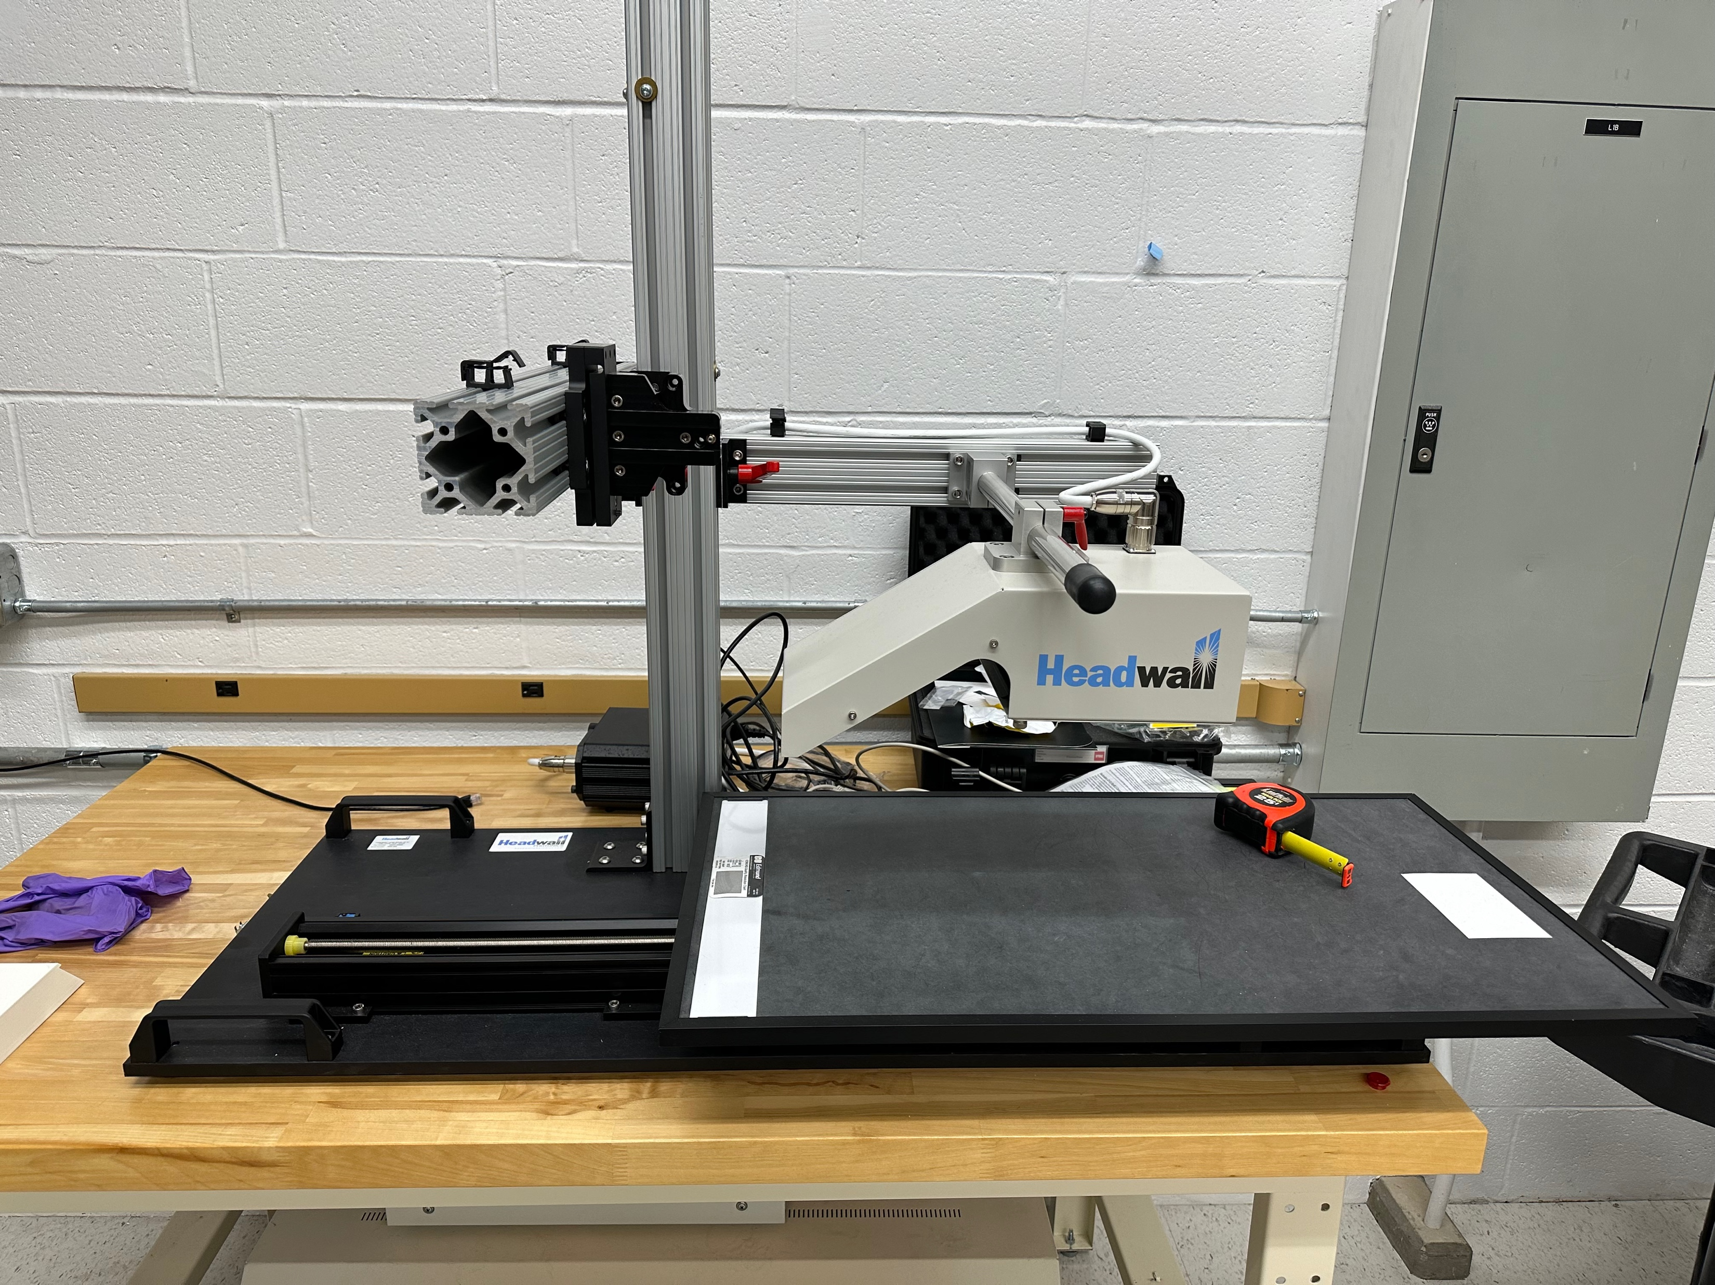

Slide 35
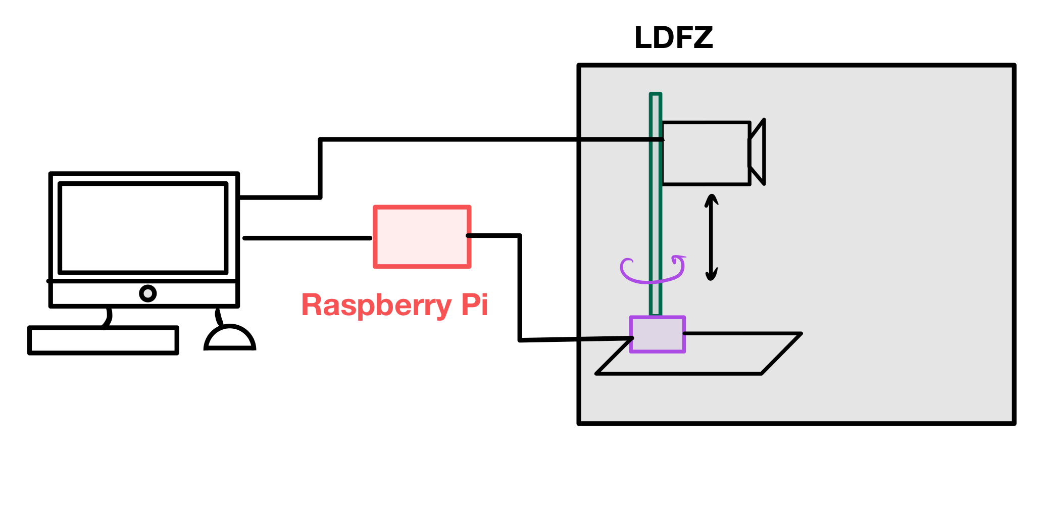
Notes:
How do we sync the motor with the image capture? We are replacing the stage with the motor

Slide 36
Extra Slides – Streaming

Slide 37
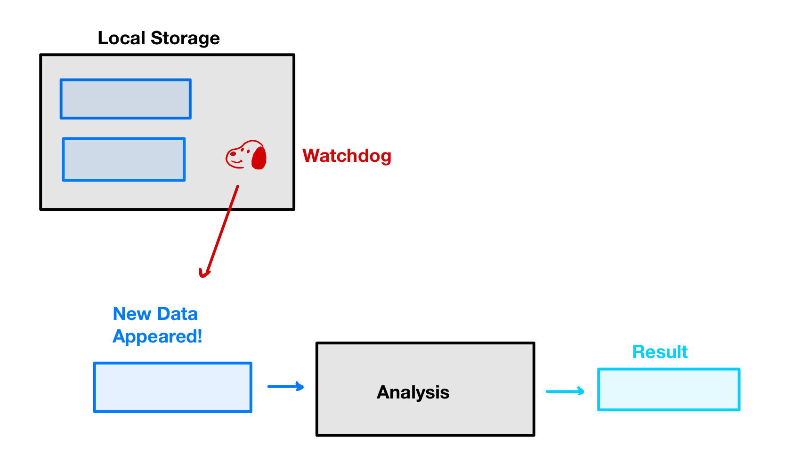

Slide 38
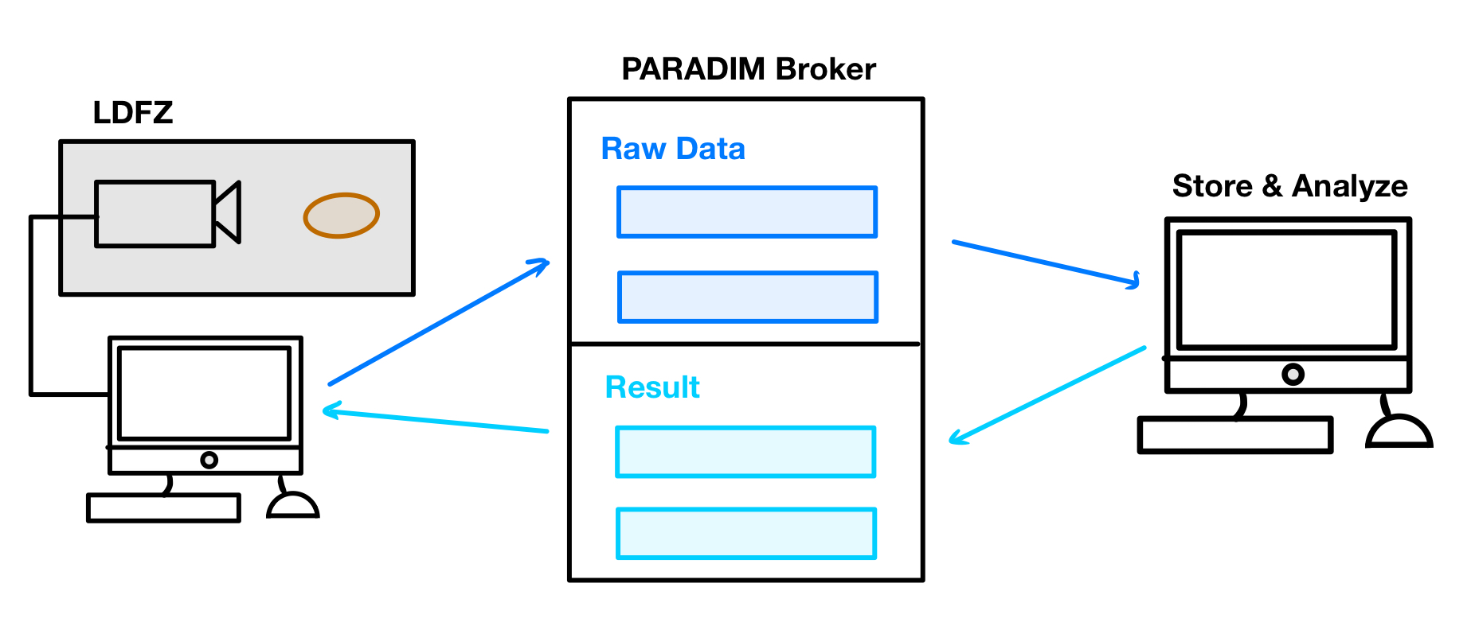
Notes:
Animate in one piece at a time

Slide 39
